Slide 1
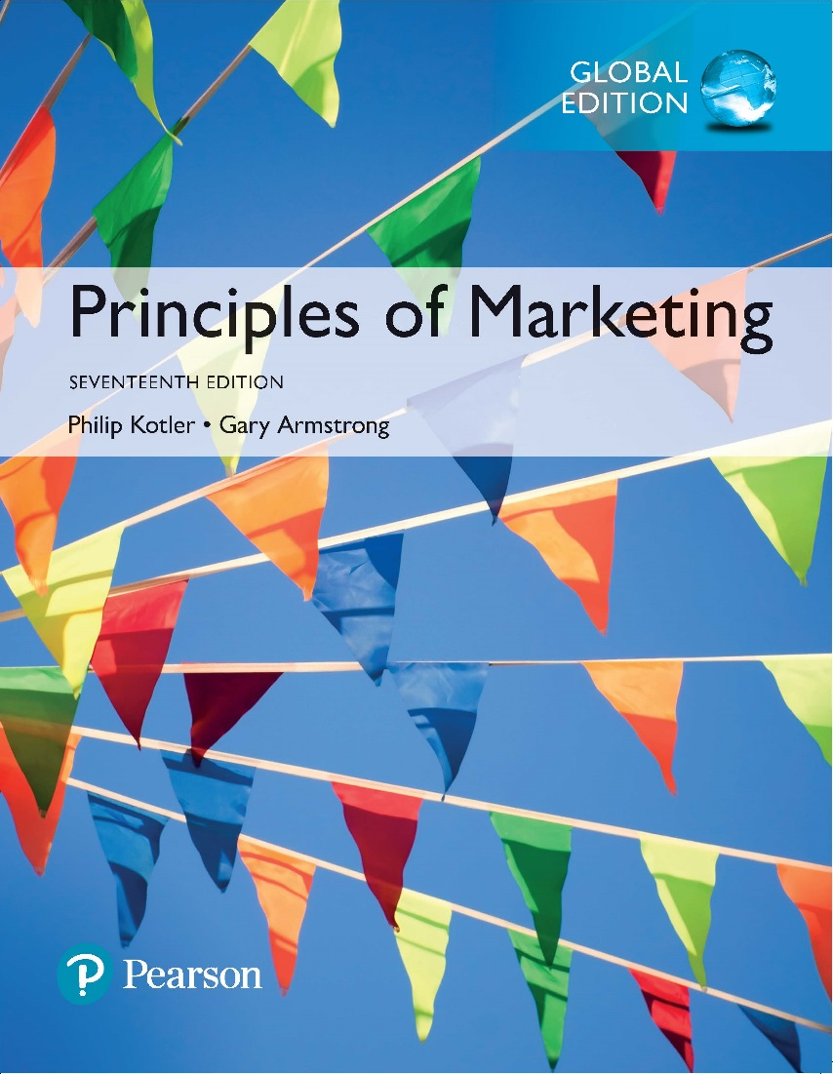
Principles of Marketing Seventeenth Edition
Chapter 14
Engaging Consumers and Communicating Customer Value: Integrated Marketing Communication Strategy
Copyright © 2018 Pearson Education Ltd. All Rights Reserved.

Slide 2
Learning Objectives
14-1 Define the five promotion mix tools for communicating customer value.
14-2 Discuss the changing communications landscape and the need for integrated marketing communications.
14-3 Outline the communication process and the steps in developing effective marketing communications.
14-4 Explain the methods for setting the promotion budget and factors that affect the design of the promotion mix.

Slide 3
Learning Objective 1
Define the five promotion mix tools for communicating customer value.
Notes:
Discussion Question
List and briefly describe the five major promotion mix tools.
Learning Objective 1 Summary
A company’s total promotion mix—also called its marketing communications mix—consists of the specific blend of advertising, personal selling, sales promotion, public relations, and direct and digital marketing tools that the company uses to engage consumers, persuasively communicate customer value, and build customer relationships. Advertising includes any paid form of nonpersonal presentation and promotion of ideas, goods, or services by an identified sponsor. In contrast, public relations focuses on building good relations with the company’s various publics. Personal selling is personal presentation by the firm’s sales force for the purpose of making sales and building customer relationships. Firms use sales promotion to provide short-term incentives to encourage the purchase or sale of a product or service. Finally, firms seeking immediate response from targeted individual customers use direct and digital marketing tools to engage directly with customers and cultivate relationships with them.

Slide 4
The Promotional Mix
The promotion mix is the specific blend of promotion tools that the company uses to persuasively communicate customer value and build customer relationships.
Notes:
A company’s total promotion mix—also called its marketing communications mix--consists of the specific blend of advertising, public relations, personal selling, sales promotion, and direct marketing tools that the company uses to engage consumers, persuasively communicate customer value, and build customer relationships.

Slide 5
The Promotional Mix
Advertising is any paid form of nonpersonal presentation and promotion of ideas, goods, or services by an identified sponsor.
Broadcast
Print
Online
Mobile
Outdoor
Notes:
Advertising refers to any paid form of nonpersonal presentation and promotion of ideas, goods, or services by an identified sponsor. Advertising includes broadcast, print, online, mobile, outdoor, and other forms.

Slide 6
The Promotional Mix
Sales promotion is a short-term incentive to encourage the purchase or sale of a product or service.
Discounts
Coupons
Displays
Demonstrations
Notes:
Discussion Question
What sales promotions have you seen in the last two months?
Students will often mention similar coupon books, fast food contests, and demonstrations in stores.

Slide 7
The Promotional Mix
Personal selling is the personal interaction by the firm’s sales force for the purpose of engaging customers, making sales, and building customer relationships.
Notes:
Personal selling includes:
Sales presentations
Trade shows
Incentive programs

Slide 8
The Promotional Mix
Public relations involves building good relations with the company’s various publics by obtaining favorable publicity, building up a good corporate image, and handling or heading off unfavorable rumors, stories, and events.
Notes:
Examples of public relations include press releases, sponsorships, events and Web pages.

Slide 9
The Promotional Mix
Direct and digital marketing involves engaging directly with carefully targeted individual consumers and customer communities to both obtain an immediate response and build lasting customer relationships.
Notes:
Direct and digital marketing includes:
Direct mail
Catalogs
Online and social media
Mobile marketing

Slide 10
Learning Objective 2
Discuss the changing communications landscape and the need for integrated marketing communications.
Notes:
Discussion Question
Why is there a need for integrated marketing communications?
Learning Objective 2 Summary
The explosive developments in communications technology and changes in marketer and customer communication strategies have had a dramatic impact on marketing communications. Advertisers are now adding a broad selection of more-specialized and highly targeted media and content—including online, mobile, and social media—to reach smaller customer segments with more personalized, interactive messages. As they adopt richer but more fragmented media and promotion mixes to reach their diverse markets, they risk creating a communications hodgepodge for consumers. To prevent this, companies are adopting the concept of integrated marketing communications (IMC). Guided by an overall IMC strategy, the company works out the roles that the various promotional tools and marketing content will play and the extent to which each will be used. It carefully coordinates the promotional activities and the timing of when major campaigns take place.

Slide 11
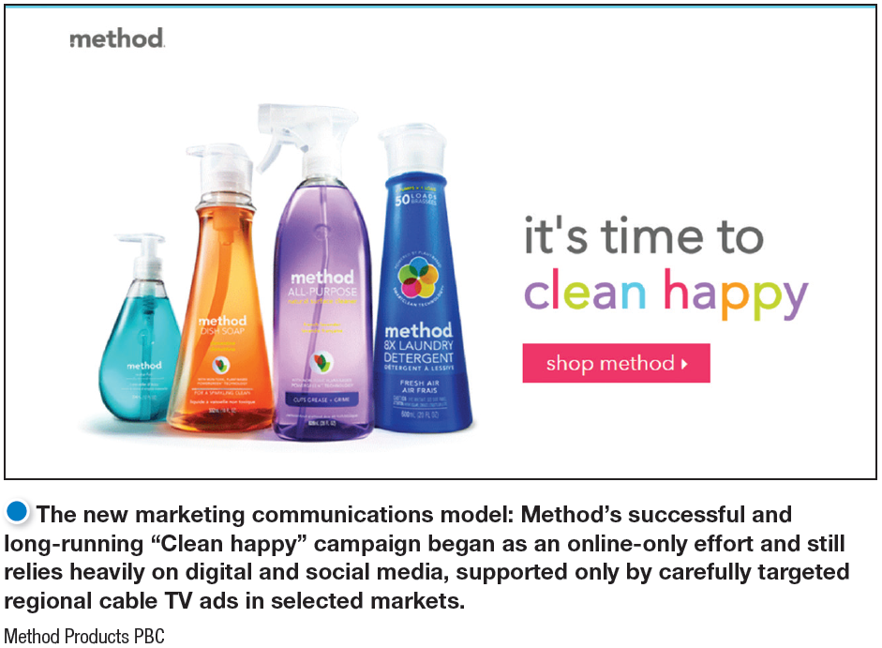
Integrated Marketing Communications
The New Marketing Communications Model
Consumers are changing.
Marketing strategies are changing.
Advances in digital technology
Notes:
Several major factors are changing the face of today’s marketing communications.
In this digital, wireless age, consumers are better informed and more communications empowered. Rather than relying on marketer-supplied information, they can use the Internet, social media, and other technologies to find information on their own.
As mass markets have fragmented, marketers are shifting away from mass marketing. More and more, they are developing focused marketing programs designed to build closer relationships with customers in more narrowly defined micromarkets.
The digital age has brought about remarkable changes in the ways companies and customers communicate with each other. There are a host of new information and communication tools—from smartphones and tablets to satellite and cable television systems to the many faces of the Internet like brand web sites, e-mail, blogs, social media and online communities, the mobile Web, and so much more.

Slide 12
Integrated Marketing Communications
The New Marketing Communications Model
Content marketing: creating, inspiring, and sharing brand messages and conversations with and among consumers across a fluid mix of paid, owned, earned, and shared channels.
من خلال ممكن مواقعي، او الناس تتكلم عني او تمدحني بدون اي عملية دفع،اوصل ترند مثلاً

Slide 13
Integrated Marketing Communications
The Need For Integrated Marketing Communications
Integrated marketing communications (IMC) involves carefully integrating and coordinating the company’s many communications channels to deliver a clear, consistent, and compelling message about the organization and its products. الرسالة تكون واضحه منسجمه بغض النغض عن الtool المستخدم
Notes:
The shift toward a richer mix of media and brand content approaches poses a problem for marketers. Consumers today are bombarded by brand content from a broad range of sources. But consumers don’t distinguish between content sources the way marketers do. In the consumer’s mind, brand content from different sources—whether it’s a Super Bowl ad, in-store display, mobile app, or a friend’s social media post—all become part of a single message about the brand or company. Conflicting content from these different sources can result in confused company images, brand positions, and customer relationships.
All too often, companies fail to integrate their various communication channels. The result is a hodgepodge of brand content to consumers. The new world of online, mobile, and social media marketing presents tremendous opportunities but also big challenges.
Marketers benefit from increased access to their customers and fresh insights into their preferences. However, marketers must manage the complexity, fragmentation choices available so it comes together in an organized way.

Slide 14
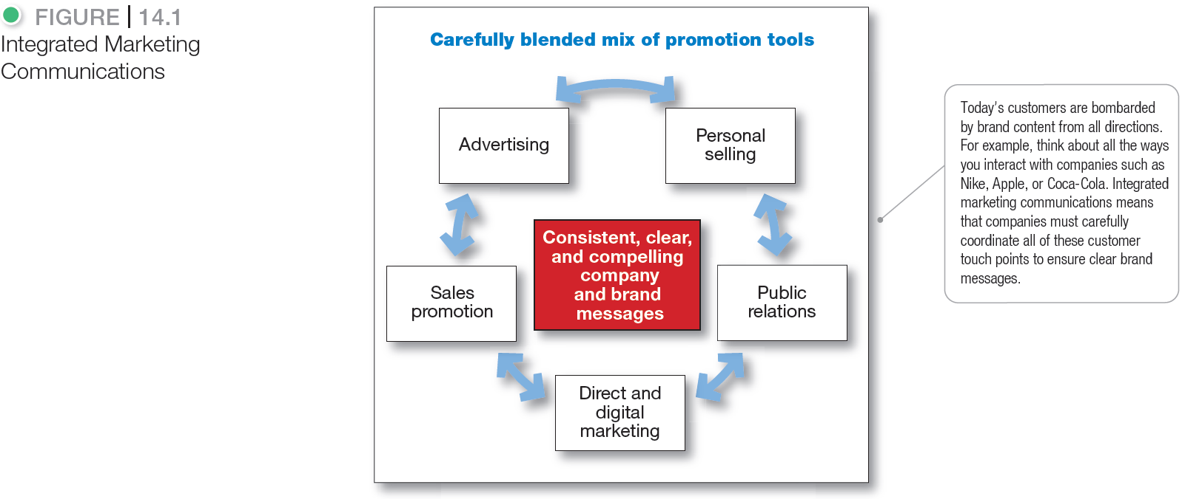
Integrated Marketing Communications
Notes:
To that end, more companies today are adopting the concept of integrated marketing communications (IMC). Under this concept, as illustrated in Figure 14.1, the company carefully integrates its many communication channels to deliver a clear, consistent, and compelling message about the organization and its brands.
Integrated marketing communications calls for recognizing all touch points where the customer may encounter content about the company and its brands. Each contact with the brand will deliver a message—whether good, bad, or indifferent. The company’s goal should be to deliver a consistent and positive message at each contact. Integrated marketing communications ties together all of the company’s messages and images. Its television and print ads have the same brand message as its e-mail and personal selling communications, and its PR materials are consistent with web site, online, social media, and mobile marketing content.

Slide 15
Learning Objective 3
Outline the communication process and the steps in developing effective marketing communications.
Notes:
Discussion Question
Name and briefly describe the nine elements of the communications process. Why do marketers need to understand these elements?
Learning Objective 3 Summary
The communication process involves nine elements: two major parties (sender, receiver), two communication tools (message, media), four communication functions (encoding, decoding, response, and feedback), and noise. To communicate effectively, marketers must understand how these elements combine to communicate value to target customers.
In preparing marketing communications, the communicator’s first task is to identify the target audience and its characteristics. Next, the communicator has to determine the communication objectives and define the response sought, whether it be awareness, knowledge, liking, preference, conviction, or purchase. Then a message should be constructed with an effective content and structure. Media must be selected, both for personal and nonpersonal communication. The communicator must find highly credible sources to deliver messages. Finally, the communicator must collect feedback by watching how much of the market becomes aware, tries the product, and is satisfied in the process.

Slide 16
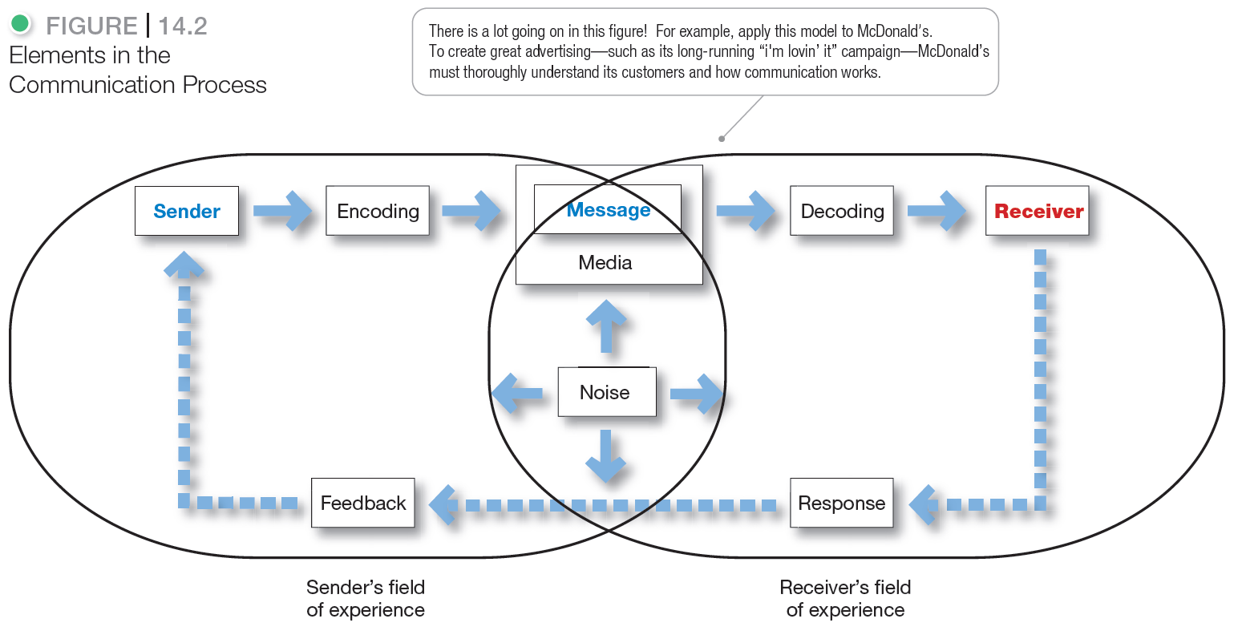
A View of the Communication Process
Notes:
The sender is the party sending the message to another party.
Encoding is the process of putting thought into symbolic form.
The message is the set of symbols the sender transmits.
Media refer to the communications channels through which the message moves from sender to receiver.
Decoding is the process by which the receiver assigns meaning to the symbols.
The receiver is the party receiving the message sent by another party.
A response is the reaction of the receiver after being exposed to the message.
Feedback is the part of the receiver’s response communicated back to the sender.
Noise is the unplanned static or distortion during the communication process which results in the receiver getting a different message than the one the sender sent.

Slide 17
Steps in Developing Effective Marketing Communication
Identify the target audience
Determine the communication objectives
Design the message
Choose the media to send the message
Select message source and collect feedback
Notes:
We now examine the steps in developing an effective integrated communications and promotion program. Marketers must identify the target audience, determine the communication objectives, design a message, choose the media through which to send the message, select the message source, and collect feedback.

Slide 18
Steps in Developing Effective Marketing Communication
Identifying the Target Audience
What will be said
How it will be said
When it will be said
Where it will be said
Who will say it
Notes:
A marketing communicator starts with a clear target audience in mind. The audience may be current users or potential buyers, those who make the buying decision or those who influence it. The audience may be individuals, groups, special publics, or the general public. The target audience will heavily affect the communicator’s decisions on the questions shown on the slide - what, how, when, where and who?

Slide 19
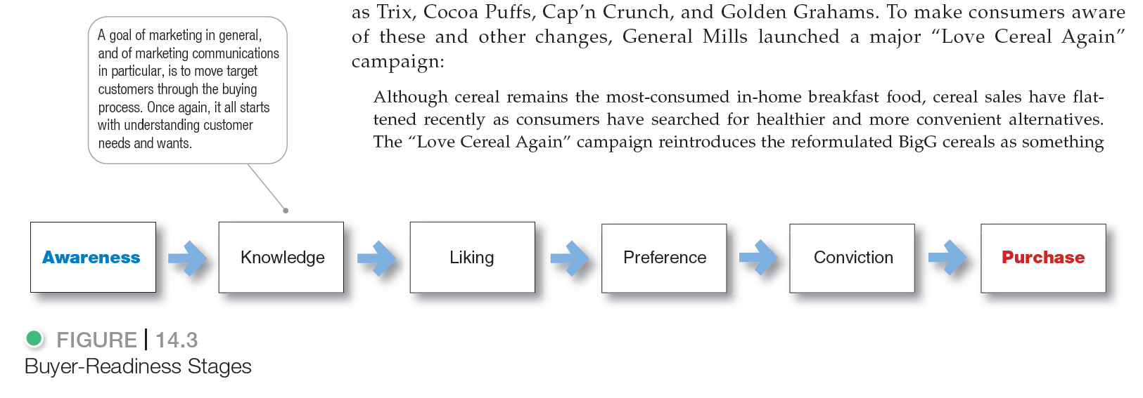

Steps In Developing Effective Marketing Communication
Notes:
The target audience may be in any of six buyer-readiness stages, the stages consumers normally pass through on their way to making a purchase. These stages are awareness, knowledge, liking, preference, conviction, and purchase (see Figure 14.3).
For example consider the introduction of Microsoft’s Surface tablet. The marketing communicator’s target market may be totally unaware of the Microsoft’s Surface tablet, know only its name, or know only a few things about it. Thus, the marketer must first build awareness and knowledge.
Assuming that target consumers know about a product, how do they feel about it? These stages include liking (feeling favorable about the Surface), preference (preferring the Surface to competing tablets), and conviction (believing that the Surface is the best tablet for them). A combination of promotion mix tools are used to create positive feelings and conviction
Finally, some members of the target market might be convinced about the product but not quite get around to making the purchase. To help reluctant consumers over such hurdles, Microsoft might offer buyers special promotional prices and upgrades, and support the product with comments and reviews from customers at its Web and social media sites and elsewhere.

Slide 20
Steps in Developing Effective Marketing Communication
Designing a Message
AIDA Model
Get Attention
Hold Interest
Arouse Desire
Obtain Action
Notes:
Having defined the desired audience response, the communicator then turns to developing an effective message. Ideally, the message should use the the AIDA model framework shown in the slide. In practice, few messages take the consumer all the way from awareness to purchase, but the AIDA framework suggests the desirable qualities of a good message.

Slide 21
Steps in Developing Effective Marketing Communication
Message Content – “What to Say”
Rational appeal relates to the audience’s self-interest. مثل اعلان جامعة سعود عن الماجستير التنفيذي، بالتالي اتكلم عنك بشكل واقعي
Emotional appeal is an attempt to stir up positive or negative emotions to motivate a purchase.سامبو دوف، الدعاية حقتها قبل كم سنه جابوا رسام عن الجمال داخلي، لعبت بالعواطف
Moral appeal is directed to an audience’s sense of what is right and proper. مثل اعلانات الفايروس، يتكلمون وش الفعل الصحيح وعسان نكون مسؤولين لازم نغسل يدينا و و و .
Notes:
Rational appeals show that the product will produce the desired benefits. Examples are messages showing a product’s quality, economy, value, or performance. Thus, an ad for Aleve makes this matter-of-fact claim: “More pills doesn’t mean more pain relief. Aleve has the strength to keep back, body, and arthritis pain away all day with fewer pills than Tylenol.”
Communicators may use emotional appeals ranging from love, joy, and humor to fear and guilt. Advocates of emotional messages claim that they attract more attention and create more belief in the sponsor and the brand.
Moral appeals are often used to urge people to support social causes, such as a cleaner environment or aid to the disadvantaged.

Slide 22
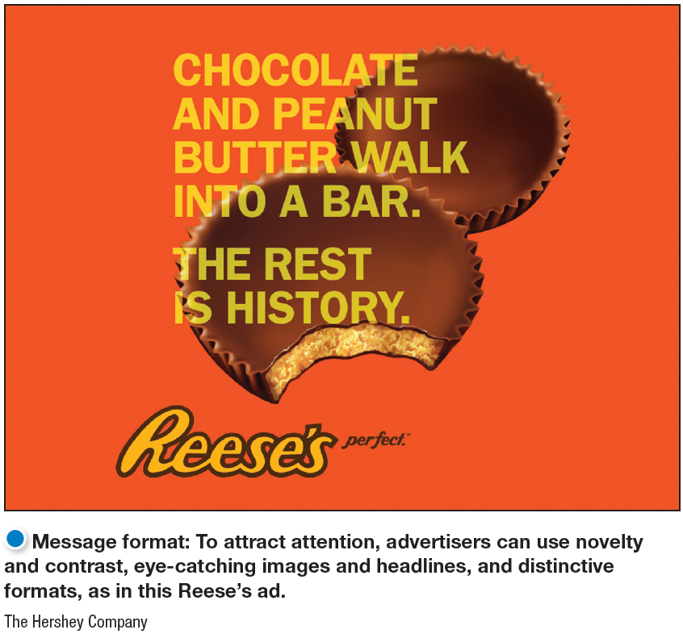
Steps in Developing Effective Marketing Communication
Designing a Message
Message content is “what to say.”
Message structure and format is “how to say it.”
Notes:
When putting a message together, the marketing communicator must decide what to say (message content) and how to say it (message structure and format).
Message Content
The marketer has to figure out an appeal or theme that will produce the desired response. There are three types of appeals: rational, emotional, and moral.
Message Structure
Marketers must also decide how to handle three message structure issues. The first is whether to draw a conclusion or leave it to the audience. Research suggests that, in many cases, rather than drawing a conclusion, the advertiser is better off asking questions and letting buyers come to their own conclusions.
Message Format
The marketing communicator also needs a strong format for the message. In a print ad, the communicator has to decide on the headline, copy, illustration, and colors. To attract attention, advertisers can use novelty and contrast; eye-catching pictures and headlines; distinctive formats; message size and position; and color, shape, and movement. For example, consider the striking Benjamin Moore paint ad shown in the slide

Slide 23
Steps in Developing Effective Marketing Communication
Choosing Communication Channels and Media
Personal communication involves two or more people communicating directly with each other.
Face to face
Phone
Mail or e-mail
Texting or Internet chat
Notes:
Personal communication channels are effective because they allow for personal addressing and feedback.
Some personal communication channels are controlled directly by the company. For example, company salespeople contact business buyers.
But other personal communications about the product may reach buyers through channels not directly controlled by the company. These channels might include independent experts—consumer advocates, bloggers, and others—making statements to buyers. Or they might be neighbors, friends, family members, associates, or other consumers talking to target buyers, in person or via social media or other interactive media. This last channel, word-of-mouth influence, has considerable effect in many product areas.

Slide 24
Steps in Developing Effective Marketing Communication
Choosing Communication Channels and Media
Opinion leaders are people whose opinions are sought by others. مثل عبالله السبع ي الثقنيه، القاسم في الطبخ، دايت نينجا في الدايت، يعني الناس يتاثرون برايهم لانهم خبرة بالموضوع
Buzz marketing involves cultivating opinion leaders and getting them to spread information about a product or service to others in their communities.
Notes:
Personal influence carries great weight, especially for products that are expensive, risky, or highly visible. Companies can take steps to put personal communication channels to work for them. They can create opinion leaders for their brands— people whose opinions are sought by others—by supplying influencers with the product on attractive terms or by educating them so that they can inform others.
An example of buzz marketing is Ford’s successful and long running Fiesta Movement campaign which hands out Fiestas to selected consumers, turning them into “Fiesta Agents.” These brand ambassadors then create buzz by sharing their experiences via blogs, tweets, Facebook updates, YouTube videos, and other social media interactions.
Social marketing firm BzzAgent takes a different approach to creating buzz. It creates customers for a client brand, then turns them into influential brand advocates.

Slide 25
Steps in Developing Effective Marketing Communication
Choosing Communication Channels and Media
Nonpersonal communication channels are media that carry messages without personal contact or feedback, including major media, atmospheres, and events.
Notes:
Major media include print media (newspapers, magazines, direct mail), broadcast media (television, radio), display media (billboards, signs, posters), and online media (e-mail and company web sites).
Atmospheres are designed environments that create or reinforce the buyer’s leanings toward buying a product. Thus, lawyers’ offices and banks are designed to communicate confidence and other qualities that might be valued by clients. البنوك تعطيك ايحاء انهم بروفيشنال، غير عيادة اااطفال مثلا او غير جو الجامعة
Events are staged occurrences that communicate messages to target audiences. For example, public relations departments arrange grand openings, shows and exhibits, public tours, and other events.
Nonpersonal communication affects buyers directly. In addition, using mass media often affects buyers indirectly by causing more personal communication. For example, communications might first flow from television, magazines, and other mass media to opinion leaders and then from these opinion leaders to others.
Interestingly, marketers often use nonpersonal communication channels to replace or stimulate personal communications by embedding consumer endorsements or word-of-mouth testimonials in their ads and other promotions.

Slide 26
Steps in Developing Effective Marketing Communication
Selecting the Message Source
The message’s impact depends on how the target audience views the communicator.
Celebrities
Athletes
Entertainers
Professionals
Health care providers
Notes:
Messages delivered by highly credible sources are more persuasive. Thus, many food companies promote to doctors, dentists, and other health-care providers to motivate these professionals to recommend specific food products to their patients. And marketers hire celebrity endorsers—well-known athletes, actors, musicians, and even cartoon characters—to deliver their messages.
A host of NBA superstars lend their images to brands such as Nike, McDonald’s, and Coca-Cola. Taylor Swift endorses Diet Coke, Keds, and CoverGirl, and Beyoncé endorses Pepsi and L’Oréal, among other brands.

Slide 27
Steps in Developing Effective Marketing Communication
Collecting Feedback
Collecting feedback involves the communicator understanding the effect on the target audience by measuring behavior resulting from the content.
Notes:
After sending the message, the communicator must research its effect on the target audience. This involves asking target audience members whether they remember the message, how many times they saw it, what points they recall, how they felt about the message, and their past and present attitudes toward the product and company.
The communicator would also like to measure behavior resulting from the message—how many people bought the product, talked to others about it, or visited the store.
Feedback on marketing communications may suggest changes in the promotion program or in the product offer itself.

Slide 28
Learning Objective 4
Explain the methods for setting the promotion budget and factors that affect the design of the promotion mix.
Notes:
Discussion Questions
Name and describe the two basic promotion mix strategies. In which strategy is advertising more important?
Learning Objective 4 Summary
The company must determine how much to spend for promotion. The most popular approaches are to spend what the company can afford, use a percentage of sales, base promotion on competitors’ spending, or base it on an analysis and costing of the communication objectives and tasks. The company has to divide the promotion budget among the major tools to create the promotion mix. Companies can pursue a push or a pull promotional strategy—or a combination of the two. The best specific blend of promotion tools depends on the type of product/market, the buyer’s readiness stage, and the PLC stage. People at all levels of the organization must be aware of the many legal and ethical issues surrounding marketing communications. Companies must work hard and proactively at communicating openly, honestly, and agreeably with their customers and resellers.

Slide 29
Setting the Total Promotion Budget and Mix
Setting the Promotional Budget
The affordable method sets the promotion budget at the level management thinks the company can afford.
The percentage-of-sales method sets the promotion budget at a certain percentage of current or forecasted sales or as a percentage of the unit sales price.
Notes:
One of the hardest marketing decisions facing a company is how much to spend on promotion. Here, we look at four common methods used to set the total budget for advertising: the affordable method, the percentage-of-sales method, the competitive parity method, and the objective-and-task method.
Some companies use the affordable method. Small businesses often use this method, reasoning that the company cannot spend more on advertising than it has. They start with total revenues, deduct operating expenses and capital outlays, and then devote some portion of the remaining funds to advertising.
The percentage-of-sales method is simple to use and helps management think about the relationships between promotion spending, selling price, and profit per unit.

Slide 30
Setting the Total Promotion Budget and Mix
Setting the Promotional Budget
The competitive-parity method sets the promotion budget to match competitors’ outlays.
The objective-and-task method develops the promotion budget by specific promotion objectives and the costs of tasks needed to achieve these objectives.
Notes:
Companies using the competitive-parity method monitor competitors’ advertising or get industry promotion spending estimates from publications or trade associations and then set their budgets based on the industry average.
The most logical budget-setting method is the objective-and-task method, which entails (1) defining specific promotion objectives, (2) determining the tasks needed to achieve these objectives, and (3) estimating the costs of performing these tasks. The sum of these costs is the proposed promotion budget.

